Slide 1


Electric Circuits
Twelfth Edition, Global Edition
Chapter 7 – Part 2
Response of First-Order R L and R C Circuits
© 2024 Pearson Education Ltd. All Rights Reserved.
Notes:
If this PowerPoint presentation contains mathematical equations, you may need to check that your computer has the following installed:
1) Math Type Plugin
2) Math Player (free versions available)
3) NVDA Reader (free versions available)

Slide 2




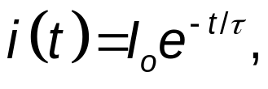

Chapter 7 – R L Natural Response
The analysis method:
Step 1 – Determine the initial inductor current,
by
analyzing the circuit for
Step 2 – Calculate the time constant,
where R is the
equivalent resistance connected to the inductor for
Step 3 – Write the equation for the inductor current:
Step 4 – Calculate other quantities of interest using the inductor current.

Slide 3


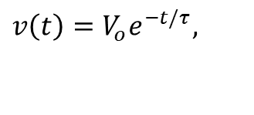
Chapter 7 – R C Natural Response
The analysis method:
Step 1 – Determine the initial capacitor voltage,
by
analyzing the circuit for
Step 2 – Calculate the time constant,
where R is the
equivalent resistance connected to the capacitor for
Step 3 – Write the equation for the capacitor voltage:
$$v\left(t\right)={V_{o}e}^{−t/τ},$$
Step 4 – Calculate other quantities of interest using the capacitor voltage.

Slide 4


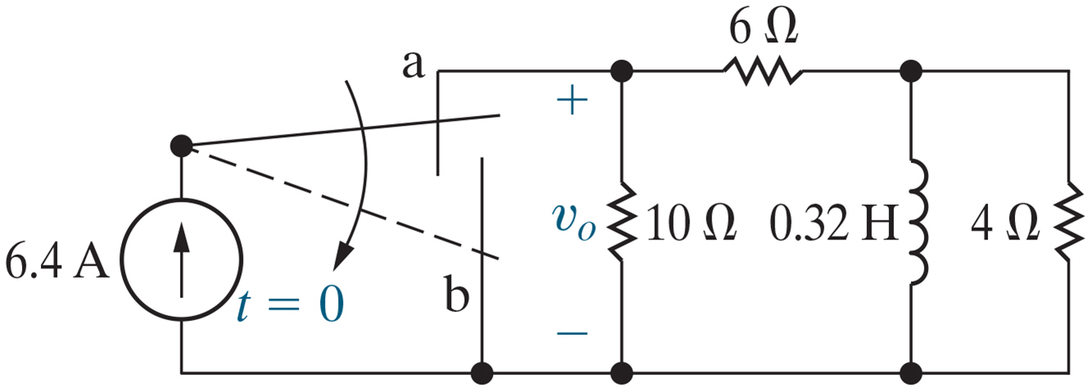

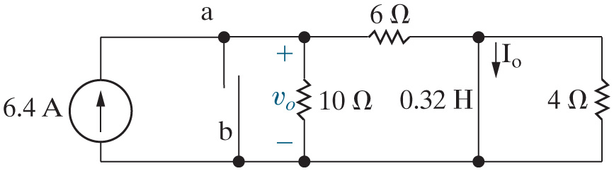
Chapter 7 – R L/R C Natural Response Examples (1 of 14)
Find
for
Step 1 – Determine the initial inductor current,
by analyzing
the circuit for
For

Slide 5



Chapter 7 – R L/R C Natural Response Examples (2 of 14)
The short circuit that replaced the inductor effectively eliminates which resistor from this circuit?
A.
B.
C.

Slide 6


Chapter 7 – R L/R C Natural Response Examples (2 of 14)
The short circuit that replaced the inductor effectively eliminates which resistor from this circuit?
A.
B.
C.

Slide 7

Chapter 7 – R L/R C Natural Response Examples (3 of 14)
What circuit analysis tool provides the most direct method to
calculate
?
A. Node voltage method
B. Current division
C. Source transformation

Slide 8
Chapter 7 – R L/R C Natural Response Examples (3 of 14)
What circuit analysis tool provides the most direct method to
calculate
?
A. Node voltage method
B. Current division
C. Source transformation

Slide 9





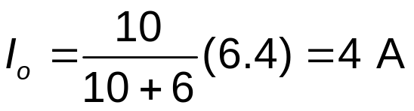
Chapter 7 – R L/R C Natural Response Examples (4 of 14)
Find
for
(continued)
Step 1 – Determine the initial inductor current,
by analyzing the circuit for
For
Current division:

Slide 10




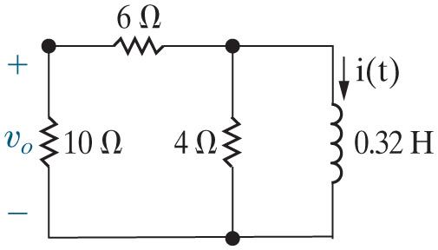
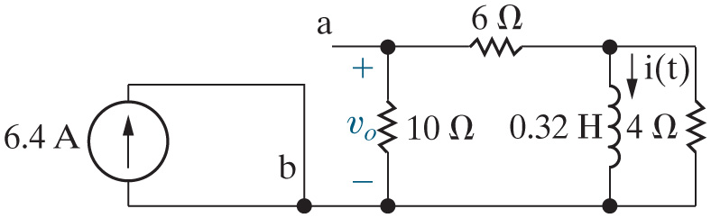
Chapter 7 – R L/R C Natural Response Examples (5 of 14)
Find
for
(continued)
Step 2 – Calculate the time constant,
where R is the equivalent
resistance connected to the inductor for
For
Simplified:

Slide 11



Chapter 7 – R L/R C Natural Response Examples (6 of 14)
The expression for the equivalent resistance seen by the inductor is
A.
B.
C.

Slide 12
Chapter 7 – R L/R C Natural Response Examples (6 of 14)
The expression for the equivalent resistance seen by the inductor is
A.
B.
C.

Slide 13





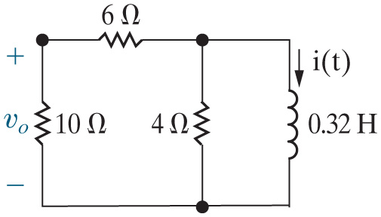




Chapter 7 – R L/R C Natural Response Examples (7 of 14)
Find
for
(continued)
Step 2 – Calculate the time constant,
where R is the
equivalent resistance connected to the inductor for
For
Step 3 – Write the equation for the inductor current:

Slide 14

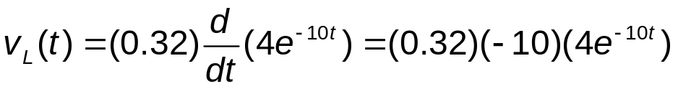


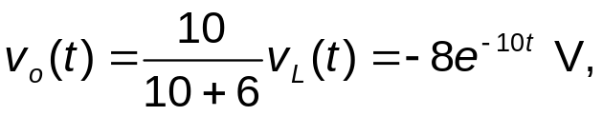

Chapter 7 – R L/R C Natural Response Examples (8 of 14)
Find
for
(continued)
Step 4 – Calculate other quantities of interest using the inductor current. For this circuit, find the voltage across the inductor,
positive at the top, and use voltage division to find
from the
inductor voltage.

Slide 15


Chapter 7 – R L/R C Natural Response Examples (9 of 14)
In circuits with inductors, we solve for the inductor current and the
solution is valid for
When we use the inductor current to
solve for any other voltage or current in the circuit, the resulting
expression is valid for
A. True
B. False

Slide 16
Chapter 7 – R L/R C Natural Response Examples (9 of 14)
In circuits with inductors, we solve for the inductor current and the
solution is valid for
When we use the inductor current to
solve for any other voltage or current in the circuit, the resulting
expression is valid for
A. True
B. False

Slide 17
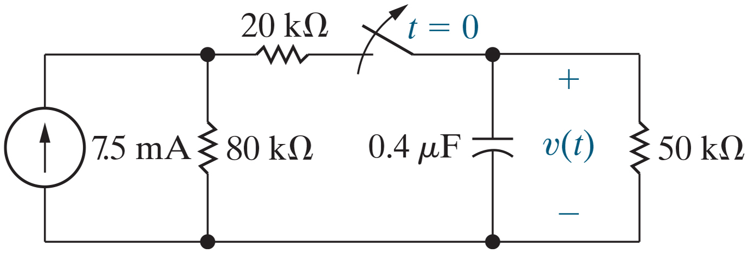


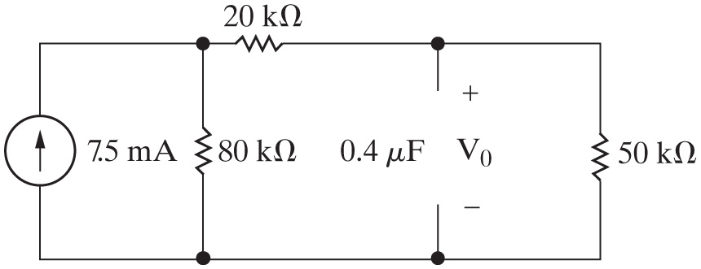
Chapter 7 – R L/R C Natural Response Examples (10 of 14)
Find the time at which 75% of the initial stored energy has been dissipated.
Step 1 – Determine the initial capacitor voltage,
by analyzing
the circuit for

Slide 18



Chapter 7 – R L/R C Natural Response Examples (11 of 14)
In the circuit used to find the initial voltage drop across the capacitor, the voltage drop across the open circuit is the same as the voltage drop across
A. The
resistor
B. The
resistor
C. The
resistor

Slide 19


Chapter 7 – R L/R C Natural Response Examples (11 of 14)
In the circuit used to find the initial voltage drop across the capacitor, the voltage drop across the open circuit is the same as the voltage drop across
A. The
resistor
B. The
resistor
C. The
resistor

Slide 20


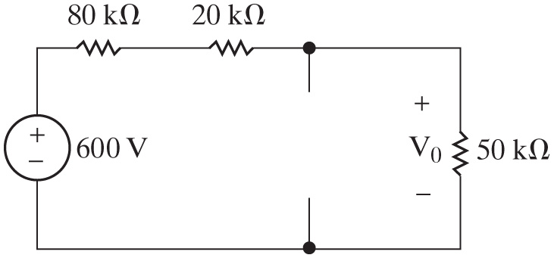
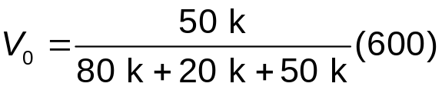

Chapter 7 – R L/R C Natural Response Examples (12 of 14)
Find the time at which 75% of the initial stored energy has been dissipated (continued).
Step 1 – Determine the initial capacitor voltage,
by analyzing
the circuit for

Slide 21



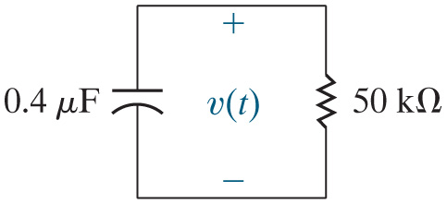


Chapter 7 – R L/R C Natural Response Examples (13 of 14)
Find the time at which 75% of the initial stored energy has been dissipated (continued).
Step 2 – Calculate the time constant,
where R is the
equivalent resistance connected to the capacitor for
Step 3 – Write the equation for the capacitor voltage:

Slide 22


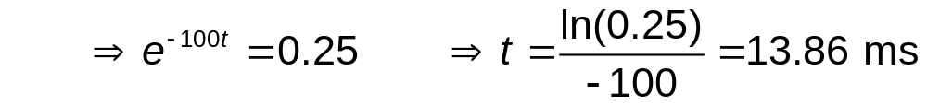
Chapter 7 – R L/R C Natural Response Examples (14 of 14)
Find the time at which 75% of the initial stored energy has been dissipated (continued).
Step 4 – Calculate other quantities of interest using the capacitor To start, calculate the initial stored energy in the capacitor.
75% of the initial energy is 6 mJ, so the energy that remains is 2 mJ. Thus,

Slide 23

Copyright
This work is protected by United Kingdom copyright laws and is provided solely for the use of instructors in teaching their courses and assessing student learning. Dissemination or sale of any part of this work (including on the World Wide Web) will destroy the integrity of the work and is not permitted. The work and materials from it should never be made available to students except by instructors using the accompanying text in their classes. All recipients of this work are expected to abide by these restrictions and to honor the intended pedagogical purposes and the needs of other instructors who rely on these materials.

